Slide 1
Final report of SIGNIFY
Signify:
Bridging Gaps with Sign Language
Group Number: 5
Team Name: Code All Night
Rain all day, code all night
Notes:
Hello everyone are group 5 and I’m excited to present final report on our project, Signify, which aims to bridge the communication gap by helping more people learn the basics of sign language.

Slide 2
TEAM MEMBER
Gong Xinyu A0295988W
Liu Peilin A0291951X
Su Chang A0296250A
Wang Xinji A0265810H
Zhang Wenqing A0296886Y
Note: The list is sorted alphabetically by the first letter of the participants' names.
Notes:
Our team consist of 5 members

Slide 3
Contents
1
Introduction
2
Business Case
3
Project Overview
Proposal
4
Product Design
5
System Modelling
6
System Development & Implementation
7
Conclusion
Notes:
Our presentation is divided into 7 parts....

Slide 4
1 Introduction
Social Background
Components of the SIGNIFY
Notes:
let me give a brief introduction of our project

Slide 5
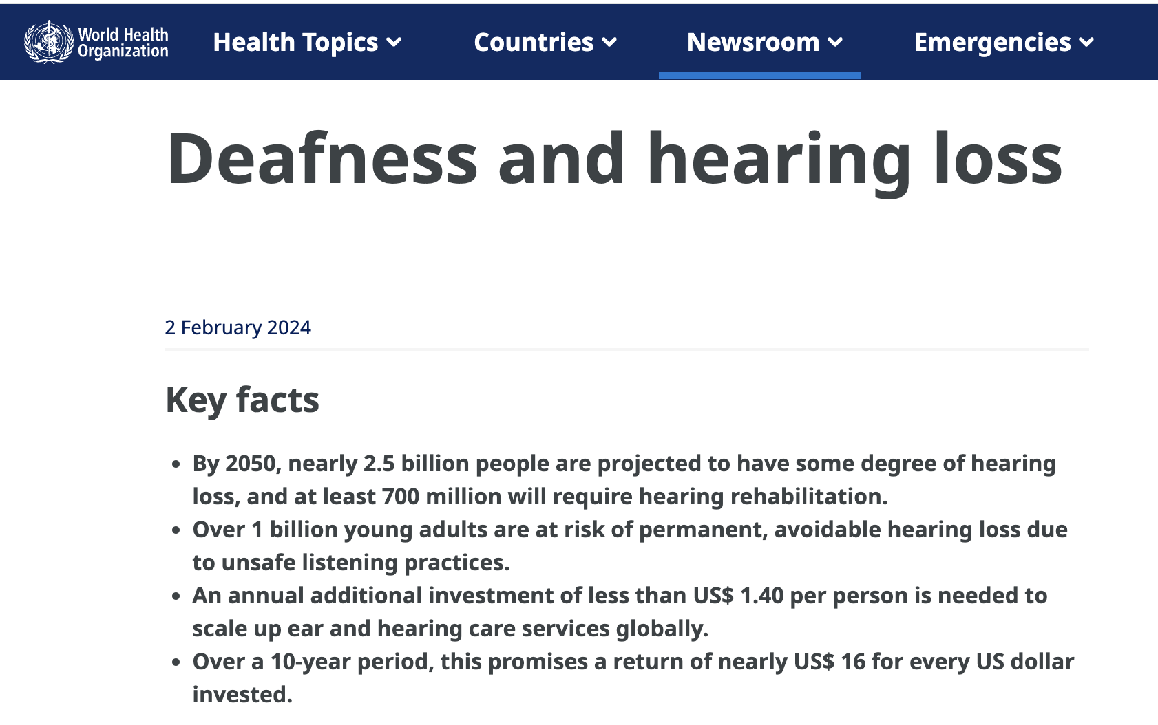

1.1 Social Background
500,000
5,400
700,000,000
In Singapore, about 500,000 people experience some level of hearing loss. Yet, only about 5,400 individuals are registered with the Singapore Association for the Deaf
"At least 700 million people are ptojected to live with disabling hearing loss worldwide"
---the World Health Organization(WHO)
Notes:
Background
Did you know that there are around 70 million deaf individuals worldwide? Most of them rely on sign language as their primary way to communicate. Additionally, the WHO reports that 700 million people are living with disabling hearing loss worldwide by 2050. Expecially in Singapore, about five hundred thousand people experience some level of hearing loss. Yet, only about 5,400 individuals are registered with the Singapore Association for the Deaf, the reach is still relatively small given the scale of the issue.

Slide 6

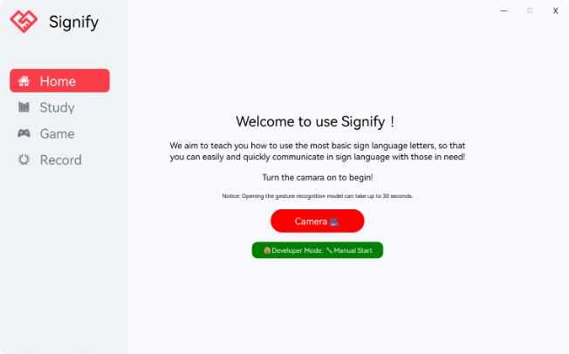
1.2 Components of the SIGNIFY
Home Page
Designed for intuitive navigation, the interface is optimized for quick access to learning resources, practice, and performance tracking. The clean and visually accessible UI ensures that users of all backgrounds can comfortably engage with the content.
Notes:
Our product Signify is designed to teach sign language in an interactive and interesting way based on gesture recognition.
Here is the home page of our APP. The clean and visually accessible UI ensures that users of all backgrounds can comfortably engage with the content.

Slide 7
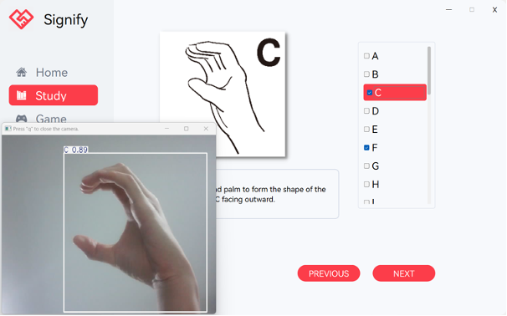
1.2 Components of the SIGNIFY
Sign Language Library
A complete library of sign language letters allows users to browse, learn, and view examples of each gesture. Each entry includes visual references and explanations to help users recognize and practice hand gestures accurately.
Using a fine-tuned YOLOv8 model, the app provides instant feedback on users’ gestures. Through camera-based tracking, the system detects and analyzes user hand gestures, ensuring accuracy and helping users improve with guided adjustments.
Notes:
A complete library of sign language letters allows users to browse, learn, and view examples of each gesture.
We integrate fine-tuned YOLOv8 model, which can provides instant feedback on users’ gestures.

Slide 8
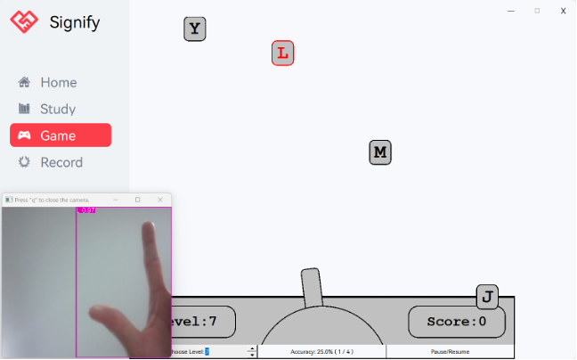
1.2 Components of the SIGNIFY
Interactive Game Mode
An engaging game feature challenges users to sign the correct letter fall from the screen top, encouraging faster recognition and response time. Users can practice individual letters in an enjoyable environment, receiving feedback for each gesture.
Notes:
An engaging game feature challenges users to sign the correct letter fall from the screen top, encouraging faster recognition and response time.

Slide 9
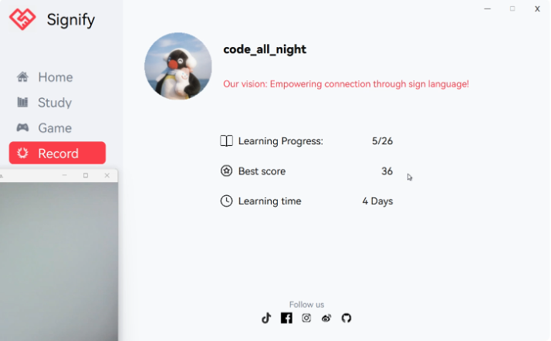
1.2 Components of the SIGNIFY
Profile Page
The “Profile” page tracks each user’s learning progress, game performance, and practice milestones. Users can monitor their improvements, fostering a personalized learning experience.
Notes:
The “ Profile ” page tracks each user’s learning progress, game performance, and practice milestones. Learning process is defined by the number of letter clicked in the study page. Maximum score can be updated after finishing a game.

Slide 10
2 Business Case
usiness Case
Problem Statement
Market Research
Proposed Solution
Notes:
We did some BUSINESS research for Signify

Slide 11



2.1 Problem Statement
In-Person Classes
Online Tutorials
Books/Printed Materials
Although these are highly effective due to direct interaction with instructors, they are often expensive and require consistent time commitments. Many people are unable to attend due to busy schedules or geographic limitations, and they wouldn't be willing to pay the high cost of learning sign language if they didn't have a disabled person around them.
Platforms such as YouTube or dedicated sign language websites provide some flexibility in learning. However, they generally lack real-time feedback, making it difficult for learners to know if they are performing the signs correctly. Without guided practice, learners often struggle to apply the signs in real-life situations.
While these provide a static reference, they cannot adequately demonstrate the dynamic nature of sign language, such as the flow and movement of signs, which are crucial aspects of communication. This limits the effectiveness of learning from books alone. These existing methods lack interactivity, real-time feedback, and flexibility, which are crucial for retaining and applying sign language in practical settings.
Notes:
For those interested in learning sign language, there are common methods but each has significant limitations, like major time commitment, lack real-time feedback.
These limitations highlight the need for a more interactive, accessible, and engaging solution.

Slide 12


2.2 Proposed Solution
Signify Key Feature
Target User
Individuals Interested in Learning Sign Language
  Students, educators, and adults who wish to communicate effectively with the deaf community.
Parents of Hearing-Impaired Children
  Helps parents engage and communicate better with their children through sign language.
Educators and Support Staff
  Enables teachers and caregivers to incorporate sign language, enhancing inclusivity in educational settings.
Organizations and Community Groups
  A resource for training programs and workshops, promoting inclusion within the community.
General Public
  Raises awareness and understanding of sign language, fostering empathy and social inclusion.
Real-time Feedback
  AI-powered gesture recognition provides instant corrections, ensuring accurate practice and effective learning.
Gamification
  Achievements and progress tracking keep users motivated and engaged, addressing the challenge of low engagement in traditional learning methods.
Flexible & Accessible
  Learn anytime, anywhere, overcoming time and geographical limitations of in-person classes.
Cost-effective
  An affordable solution that democratizes access to sign language education, especially for regions with limited resources.
Notes:
Signify addresses the limitations of traditional sign language learning by offering these key features.
The target users range widely.

Slide 13



2.3 Market Research
Government Investment
Worldwide, governments allocate 1-2% of GDP to disability services, including inclusive education and assistive technologies [4]. Singapore’s Enabling Masterplan 2030 earmarks SGD 100 million for disability support, focusing on communication and educational tools [5]
Global Growth of market
The assistive technology market is projected to grow from USD 22.5 billion (2020) to USD 31.7 billion by 2028 (CAGR of 5.9%) [3]. This growth is driven by increasing demand for communication tools for the deaf and hearing-impaired communities.
Commercial Potential for Signify
With rising demand for inclusive communication tools and strong government support, Signify is well-positioned to capture a significant market share. Its AI-powered gesture recognition, real-time feedback, and practical scenarios make it a unique solution for today’s accessibility-focused market.
Notes:
Governments worldwide are increasingly investing in disability services and the global assistive technology market is alos expected to grow significantly
With this demand and strong government support, Signify is well-positioned to capture a substantial market share.

Slide 14
3 Project Overview
Project Scope
Responsibility Distribution

Slide 15


3.1 Project Scope
App overview
Key Features:
Intuitive Interface
Real-Time Gesture Recognition
Interactive Games
Personalized Progress Tracking
Use Cases:
Browse Sign Language Information
Practice and Interactive Games
Monitor Progress:
Notes:
Signify aims to create an interactive computer app that teaches users the basics of sign language through an intuitive interface, real-time gesture recognition, enjoyable form of game, and personalized progress tracking. The app is designed to bridge communication gaps by enabling users to learn and practice sign language quickly and effectively. The primary user cases include browsing sign language information, engaging in practice and interactive games, and monitoring learning progress.

Slide 16
3.1 Project Scope
Resources Requirements
Hardware:
Model Training: A local or cloud-based system equipped with an RTX 3090 GPU.
Deploying & Usage: A Windows 10/11 64-bit system (local or cloud-based) with a camera and at least 2GB of available disk space.
Software:
Front End: Window device
Back End: Fine-tuned: YOLOv8 model
Programming Languages: Python, C++
Notes:
For developing and deploying this project, we propose the following resources: Including hardware and software

Slide 17
3.2 Responsibility Distribution
Full Name | Student ID | Roles and Responsibility
Gong Xinyu | A0295988W | Marketing Researcher Record Page Developer
Liu Peilin | A0291951X | Study Page Developer UI/UX Developer
Su Chang | A0296250A | Administrative Leader Game Part Developer System Integrator and Optimizer
Wang Xinji | A0265810H | UI/UX Designer Gesture Recognition Model Trainer & Tuner Test Development Engineer
Zhang Wenqing | A0296886Y | Home Page Developer UI/UX Developer
Notes:
Our responsibility distribution is shown in the figure.

Slide 18
4 System design & Development
System Design
System Development
Game Development
Model Selection & Motivation
Data Collection and Preparation
Training & Results
Notes:
In this section, I will introduce the core elements of our system design, which are divided into four key areas. Let’s move on to the details.

Slide 19
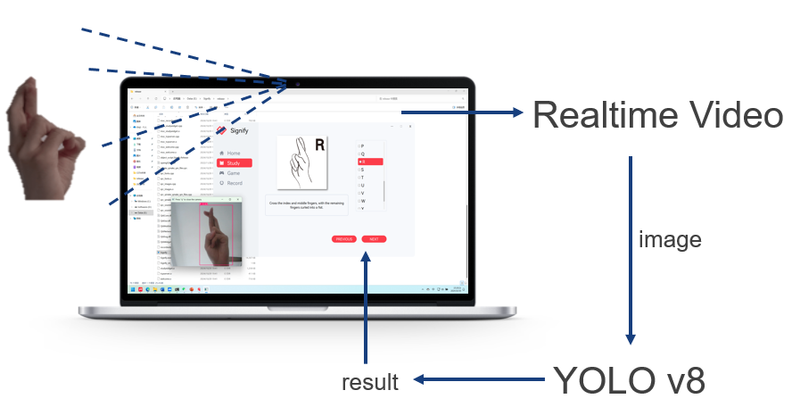
4.1 System Design
Notes:
This slide shows our system design architecture: the camera captures real-time hand gestures, which are processed by the YOLOv5 model to recognize specific signs. Results are displayed instantly on the app, providing users with accurate, real-time feedback for a quality learning experience.

Slide 20
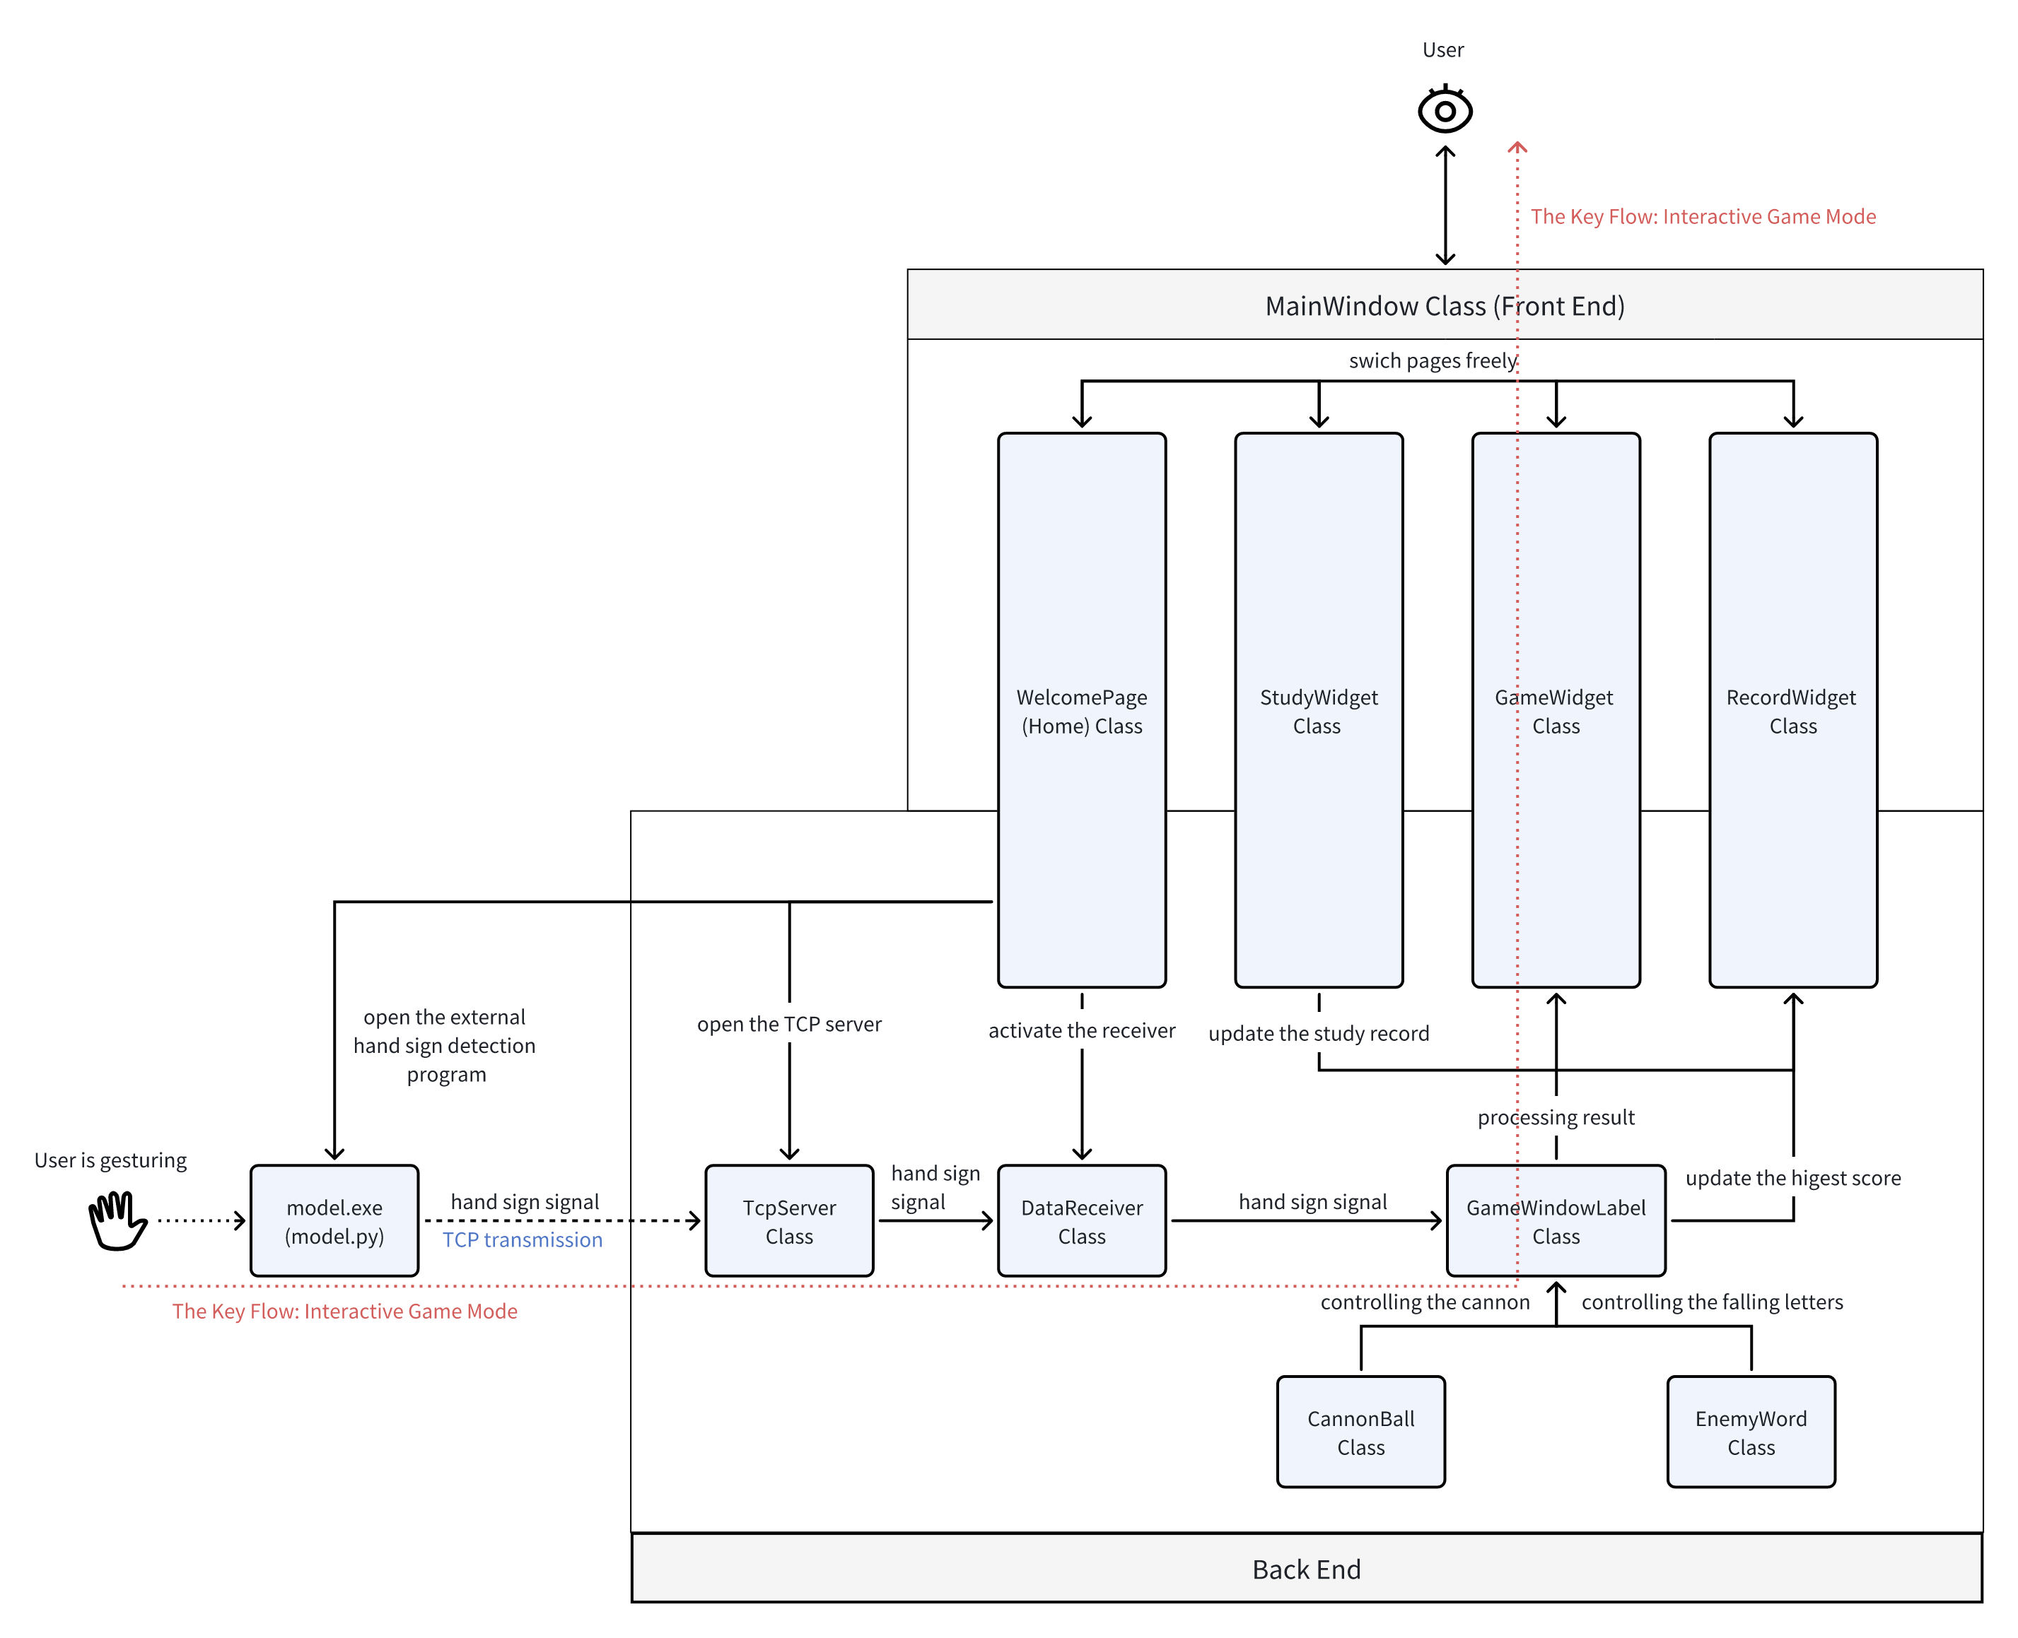
4.2 System Development
Components: Nine C++ classes and one compiled Python script.
Main Classes:
MainWindow: User-friendly interface for navigation.
Page Classes: Handle user interactions.
GameWindowLabel: Interprets gestures for game control.
Core Feature: Interactive Game Mode with real-time gesture recognition, detailed in the next section
Notes:
This figure illustrates our system architecture, featuring nine C++ classes and a Python script (.exe) that implement the core functions. The MainWindow class manages navigation, while four additional page classes support front and back-end interactions. Auxiliary classes like GameWindowLabel process hand gestures for gameplay control, such as moving the cannon and managing falling letters. The central feature, an Interactive Game Mode powered by YOLO, enables real-time gesture recognition for in-game actions

Slide 21
4.3 Game Development
GameWidget: Manages the game interface, difficulty, hand-sign inputs, and tracks player stats.
GameWindowLabel: Handles visuals like falling letters, cannon, and scores; controls gameplay flow.
CannonBall & EnemyWord: Simulate cannonball movement and manage letter targets, marking words as “destroyed” when fully signed
Notes:
“game mode lets players sign letters to ‘shoot down’ falling targets. GameWidget manages the interface and difficulty, tracking real-time stats. GameWindowLabel handles visuals and controls. Finally, CannonBall and EnemyWord simulate cannon shots and manage letter targets, creating an engaging, interactive experience.

Slide 22
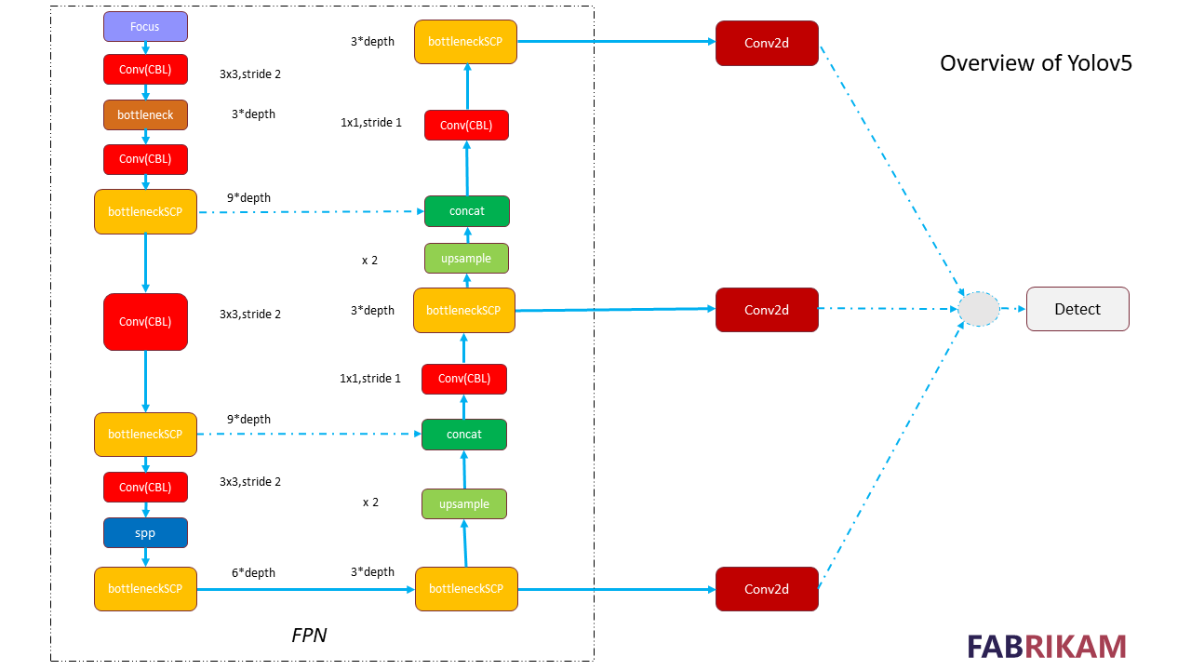
4.4 Model Selection & Motivation
Overview of YOLO
YOLO (You Only Look Once) processes the entire image in a single pass for real-time object detection, significantly enhancing efficiency compared to multi-stage models.
Key Architectural Points :
Backbone: Extracts multi-level features using a CNN structure like CSPDarknet.
FPN: Combines multi-scale features for objects of various sizes.
Detection Head: Generates bounding boxes and classifications for objects of different scales.
Notes:
YOLO processes the entire image in one pass, making it efficient for real-time object detection. The architecture includes a Backbone for feature extraction, FPN for multi-scale features, and a Detection Head for bounding boxes and classifications.

Slide 23
4.4 Model Selection & Motivation
YOLOv5
We initially chose YOLOv5 for its efficient design and existing success in real-time applications. However, limitations emerged during testing, particularly with complex backgrounds and gesture details.
Advantages:
Lightweight and Efficient Design
Successful Applications in Real-time Gesture and Object Detection
Limitations:
Background Sensitivity: YOLOv5 struggled with accuracy in complex backgrounds, leading to misrecognition.
Gesture Detail Handling: The model had difficulties capturing fine details of finger and hand gestures, especially in recognizing intricate sign language alphabets.
Notes:
Initially, we chose YOLOv5 for its lightweight design and success in real-time applications, making it suitable for gesture recognition. However, during testing, we encountered limitations. YOLOv5 struggled with complex backgrounds, leading to misrecognition, and had difficulties in capturing fine gesture details, especially finger movements in sign language.

Slide 24
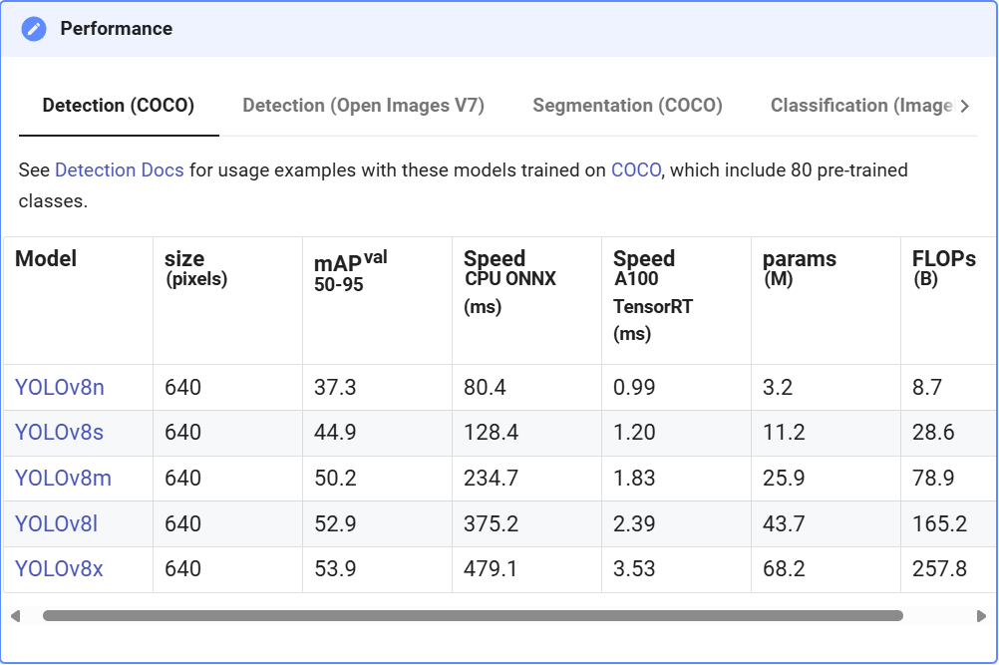
4.4 Model Selection & Motivation
Shift to YOLOv8
To improve accuracy and capture gesture details, YOLOv8 was chosen over YOLOv5. Key advancements include:
Enhanced Feature Extraction :Uses CSPNet with refined convolutional blocks and introduces a new P2 layer for better detail capture (e.g., finger movements).
Adaptive Anchor Boxes :Dynamic anchor box adjustment based on dataset, improving precision for detailed gestures.
Improved Background Handling :Optimized loss functions and SPPF module enhance robustness in complex scenes and varied lighting.
Optimized Training Strategy ;Techniques like Mosaic augmentation and Adaptive Label Smoothing increase sample diversity and stability.
The exceptional performance of YOLO v8
Notes:
To overcome YOLOv5’s limitations, we shifted to YOLOv8, which improves feature extraction with CSPNet and adds adaptive anchor boxes for better accuracy. Enhanced background handling and optimized training strategies make it robust across diverse conditions.

Slide 25

4.5 Data Collection and Preparation
Data Collection
Gathered images of sign language letters from public datasets.
Ensured data diversity with variations in lighting, backgrounds, and angles to represent real-world applications.
Data Preparation
Normalized images to maintain input consistency.
Applied data augmentation techniques:
  Image rotation
  Scaling
  Contrast adjustment
Performed rigorous data cleaning to remove blurry or low-quality images, ensuring high-quality data for model training.
Apply data augmentation to images
Notes:
We collected diverse sign language images and applied data augmentation (rotation, scaling, contrast) to improve adaptability. Rigorous data cleaning ensured high-quality inputs for training.

Slide 26
4.6 Training & Results
Pretrained Weights Initialization:
Use YOLOv8's pre-trained weights to improve initial recognition capabilities and accelerate model convergence.
Fine-Tuning & Hyperparameter Optimization:
Conducted multiple fine-tuning sessions with optimized settings, achieving model stability and improved accuracy for sign language gestures.
Data Augmentation:
Applied techniques like rotation, brightness adjustment, and translation to improve adaptability across various environments.
Results:
Achieved an F1 score of 0.87, enabling real-time recognition of 26 English alphabet gestures with high accuracy.
Notes:
Using pretrained weights, fine-tuning, and data augmentation, we achieved stable, high-accuracy recognition. The model reached an F1 score of 0.87, enabling real-time recognition of 26 alphabet gestures.

Slide 27
5 Evaluation
Notes:
To ensure that the app's recognition capabilities meet real-world demands in both accuracy and usability, we use several ways to evaluate the application.

Slide 28



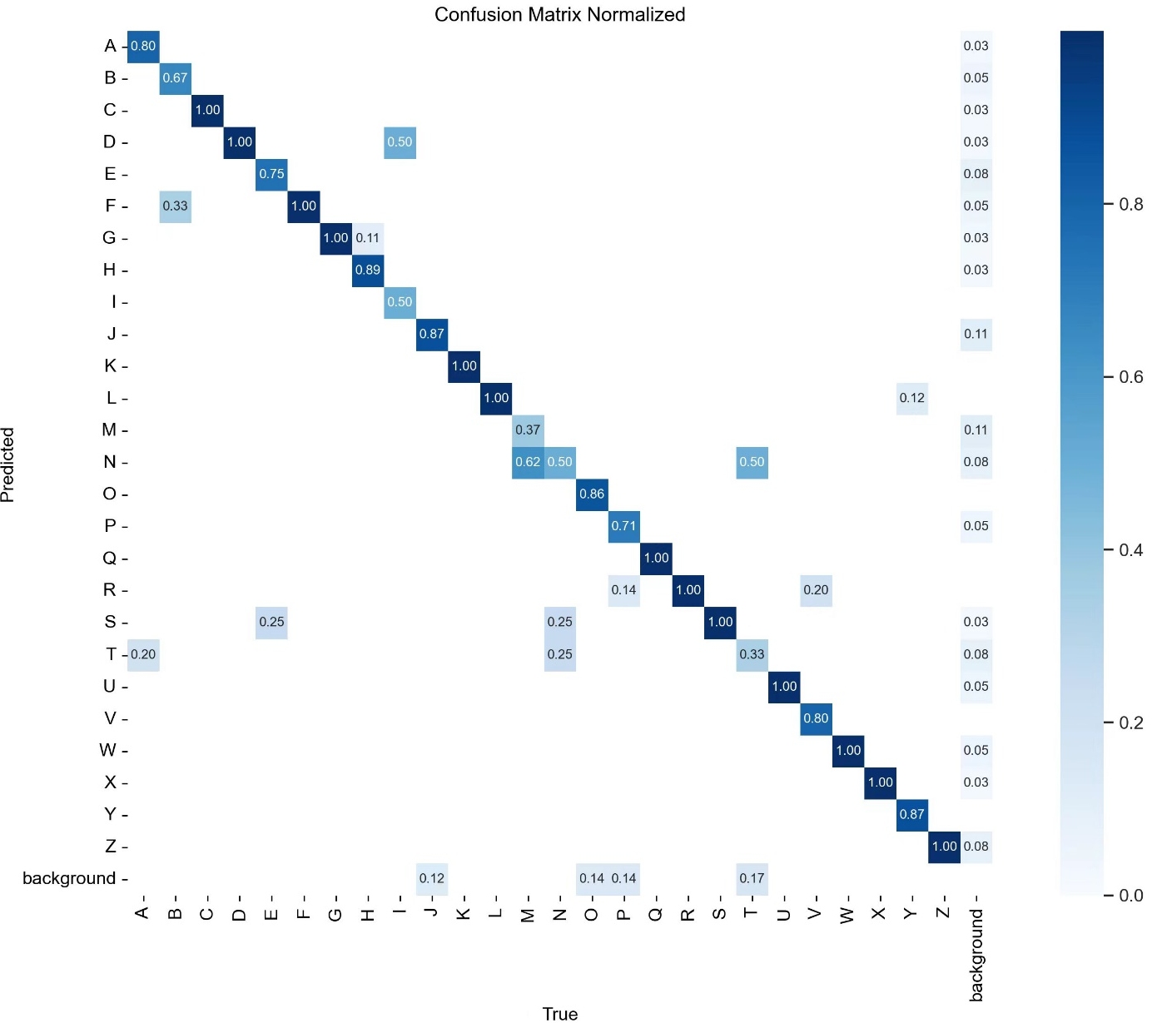
5 Evaluation
Normalized Confusion Matrix
Performance Observation:
Most letters are accurately detected
Confusion observed among letters “M” “N” and “T” due to data limitations and letter similarity.
Miss Rate:
The right-most column indicates a low miss rate across categories, demonstrating strong model accuracy.
Notes:
The confusion matrix shows high accuracy and a low miss rate. Minor confusion occurs between similar letters like ‘M,’ ‘N,’ and ‘T,’ likely due to dataset limits. Future work will expand the dataset and use data augmentation to improve results.

Slide 29
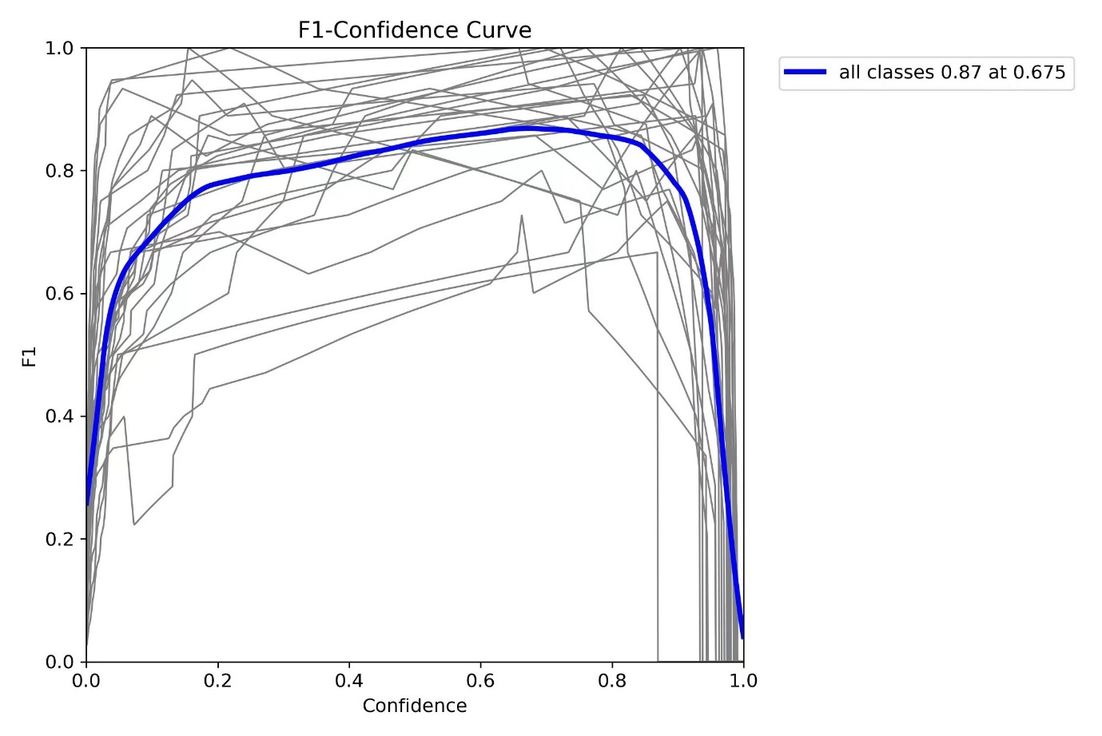
5 Evaluation
F1 Curve
F1 Score:
Measures the balance between precision and recall, ranging from 0 to 1
Formula:
F1 = 2TP / (2TP + FN + FP)
Low Thresholds: Increases recall but reduces precision, as more low-confidence predictions are classified as true.
High Thresholds: Enhances precision by classifying only high-confidence samples as true, improving model accuracy.
Optimal Range: The F1 curve shows the best balance between precision and recall within a confidence range of 0.2 to 0.8
Notes:
The F1 curve highlights the balance between precision and recall.
Our model achieves an optimal balance within the 0.2–0.8 confidence range, showing strong overall performance.

Slide 30
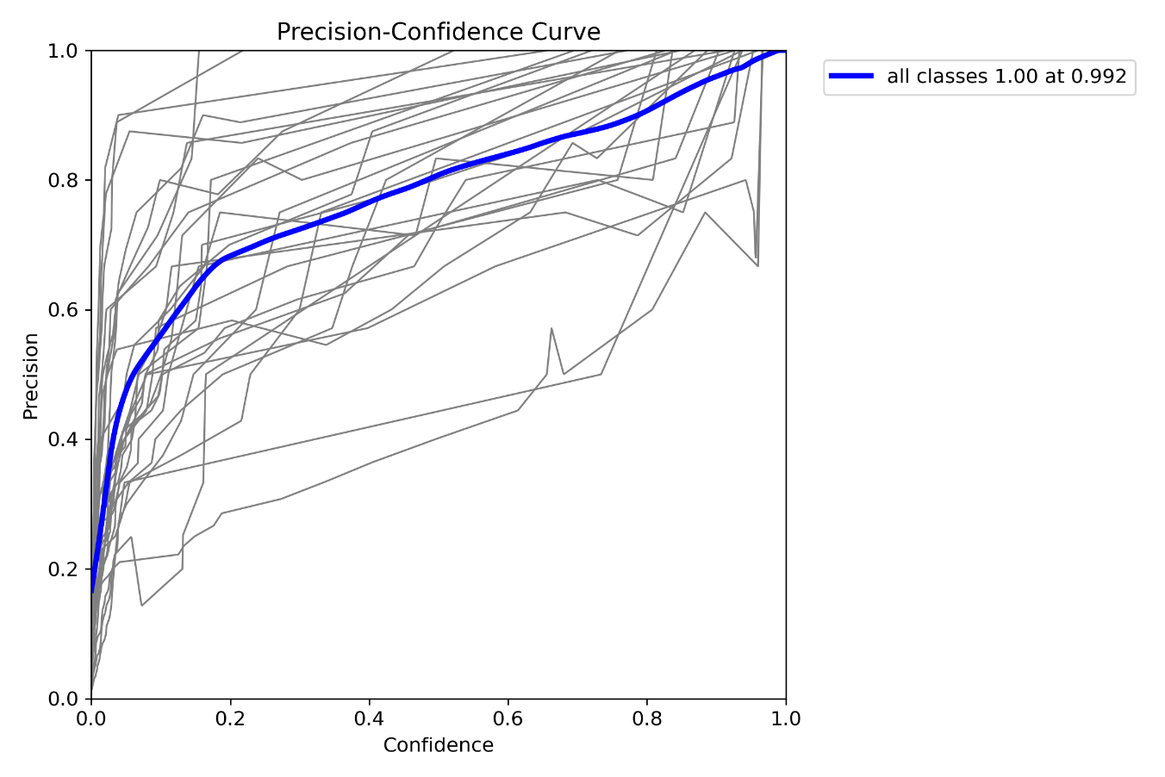
5 Evaluation
Precision Confidence Curve
Axes Interpretation:
Abscissa (X-axis): Model confidence.
Ordinate (Y-axis): Precision or recall.
Upward and Left Curving: Indicates high precision at low confidence, meaning low false alarms with high recall, showing high recognition accuracy.
Downward and Right Curving: Suggests accuracy increases with confidence but may raise missed detections, indicating poorer model performance.
Model Performance: The curve in our PCC plot trends up and to the left, confirming a low false alarm rate and high recall, indicating strong model accuracy.
Notes:
Our PCC plot demonstrates strong model performance. The curve trends up and to the left, meaning our model maintains high precision with low false alarms and high recall, even at lower confidence levels. This confirms excellent recognition accuracy.

Slide 31
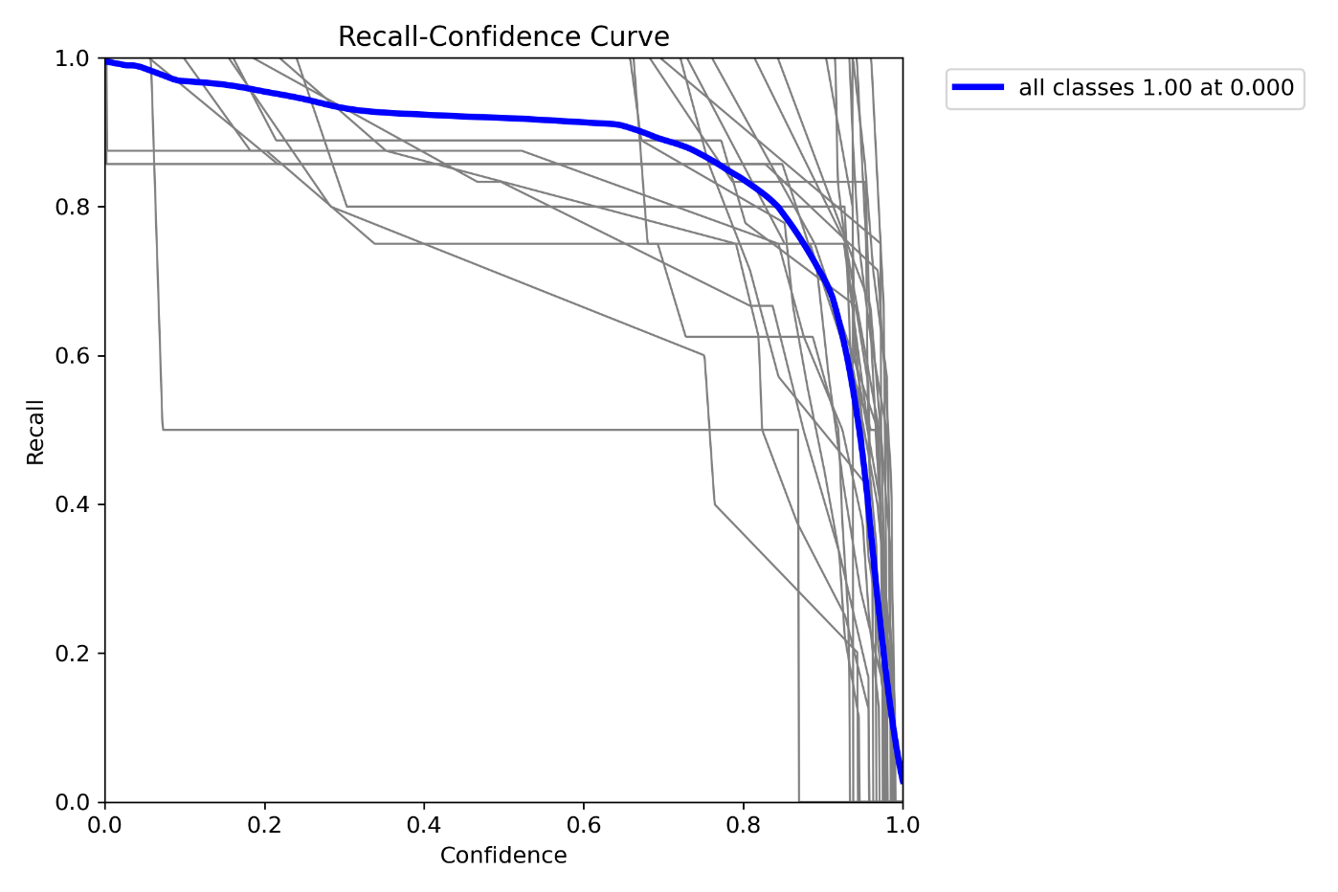
5 Evaluation
Recall Confidence Curve
Curve Insights:
Higher recall at increased confidence indicates effective object predictions and filtering of low-confidence boxes.
A steeper curve shows improved recall through effective filtering.
Model Performance: Closer curve to the top-right corner reflects better model performance in maintaining high precision and recall
Notes:
Our RCC plot shows the balance between precision and recall.
A steeper curve reflects better recall, and its proximity to the top-right corner demonstrates our model's strong performance in maintaining both high precision and recall.

Slide 32
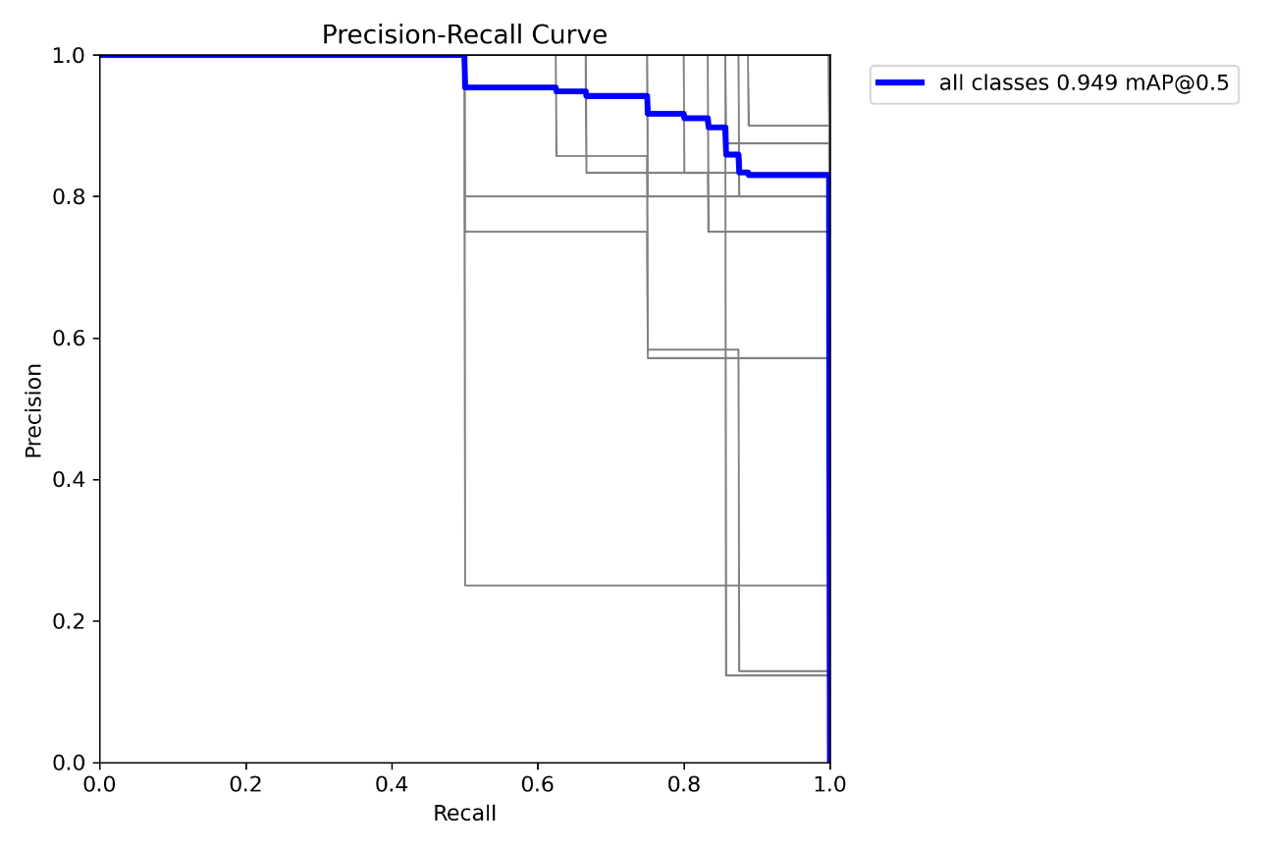
5 Evaluation
Precision Recall Curve
Definitions:
Precision: Positive predictions that are actually correct.
Recall: Actual positives correctly identified.
Axes: Recall on the X-axis, precision on the Y-axis.
Increasing recall usually decreases precision, showing a trade-off.
Performance Indicators:
A curve near the top-right corner indicates high precision and recall, reflecting accurate predictions.
A curve closer to the bottom-left suggests challenges in achieving both metrics.
Model Performance: Our PR curve is near the top-right corner, indicating that Signify effectively maintains high precision and recall.
Notes:
The PR curve shows the trade-off between precision and recall, with precision on the Y-axis and recall on the X-axis. Our curve is close to the top-right corner, signifying that our model achieves high precision and recall, ensuring accurate predictions

Slide 33
6 CONCLUSION
Key Takeaway
Future Development

Slide 34
6.1 Key Takeaway
Enhanced Accessibility for Sign Language Learning
The app provides an accessible platform, enabling users to learn sign language anytime, anywhere, without the constraints of traditional in-person classes.
Improved Learning Efficiency through Real-Time Feedback
Real-time feedback allows users to make instant corrections, making the learning process more effective and efficient.
Engaging and Motivating Interactive Learning
Game-based elements, such as a sign language shooting game, keep users engaged and motivated through challenges and progress tracking.
Promoting Social Inclusion and Awareness
The app bridges the gap between the hearing and hearing-impaired communities, fostering a more inclusive society.
Notes:
Signify offers an accessible platform for learning sign language, enabling users to practice anytime, anywhere, beyond the limits of traditional classes. Its real-time feedback allows immediate corrections, making learning faster and more accurate. The app includes game elements, like a shooting game, to keep users engaged and motivated. Beyond learning, Signify promotes social inclusion, bridging the gap between hearing and hearing-impaired communities.

Slide 35
6.2 Future Development
Expansion of Vocabulary and Multilingual Support
Adding more commonly used words and support for ASL and BSL to reach a broader audience.
Enhancing AI Model Capabilities
Optimizing the model with diverse datasets to improve recognition accuracy in various real-world scenarios.
Personalized Learning Paths and Gamification Features
Introducing personalized learning paths and new game elements to keep users motivated.
Improving Study Page Functionality
Adding an automatic recording feature to evaluate gesture accuracy and track progress effectively.
Notes:
Looking ahead, Signify plans to expand its vocabulary and support for other sign languages like ASL and BSL to reach a wider audience. We aim to improve model accuracy by training on diverse datasets for reliable performance across scenarios. Future updates will offer personalized learning paths, gamification features, and enhanced tracking on the learning page to help users improve gesture skills effectively.

Slide 36
Thank you！

Slide 37
Reference
[1] World Health Organization. (2021). Deafness and Hearing Loss. Retrieved from https://www.who.int/news-room/fact-sheets/detail/deafness-and-hearing-loss
[2] Singapore Association for the Deaf. (2023). Hearing Impairment Statistics. Retrieved from https://sadeaf.org.sg
[3] Grand View Research. (2021). Assistive Technology Market Size & Share Report,2021-2028.
[4] World Bank. (2022). Disability-Inclusive Development in Global Perspective. Retrieved from https://www.worldbank.org/en/topic/disability
[5] Ministry of Social and Family Development (MSF). (2021). Enabling Masterplan 2030. Retrieved from https://www.msf.gov.sg

